Slide 1
AMAZON LEX
(Facebook Messenger Integration)
CHATBOT
Cognizant Cloud Services

Slide 2
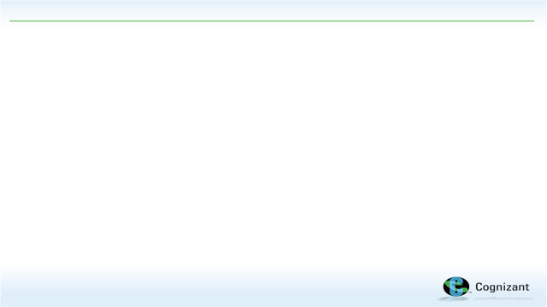







CHATBOT ARCHITECTURE
4.Get and Put functions
(User and Instance details)
Dynamo DB
1. Intents
2.Triggers Validation
lambda function
3. Triggers fulfillment lambda function
User
CreateInstance
Start_Stop_Instance
6.Triggers mail to the user
TerminateInstance
FB Messenger
Amazon Lex
AWS Lambda
5.Triggers Notification lambda function
SES
Scheduled events for the ec2 state change
Cloud watch
©2017, Cognizant

Slide 3

Create Instance
©2017, Cognizant

Slide 4
Stop Instance
©2017, Cognizant

Slide 5
Terminate Instance
©2017, Cognizant

Slide 6
Thank You
Cognizant Cloud Services

